Slide 1
Urban Freight Delivery
TRB Planning Applications Conference
Krishnan Viswanathan
June 2, 2019

Slide 2
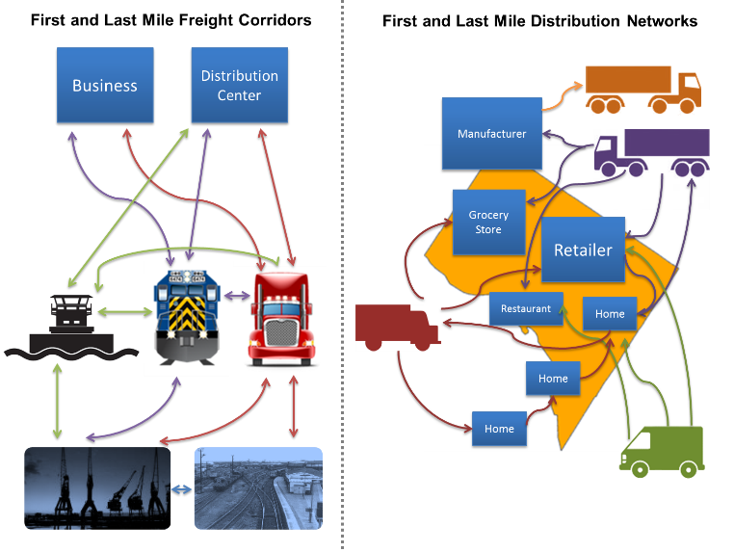
First and Last Mile Delivery
Source: FHWA
Notes:
Our increasingly urbanized population poses challenges for “first mile” and “last mile” freight movements.
Freight demand is expected to be concentrated in the large metropolitan areas where America’s population is growing the fastest. Congestion in several metropolitan population centers is already severe and could become more extreme. Increasing freight demand in these densely populated areas will complicate “first mile” movement of goods out of ports and the “last mile” movement of goods from freight hubs to their final destinations, which is often the least efficient portion of the supply chain for many consumer goods.

Slide 3
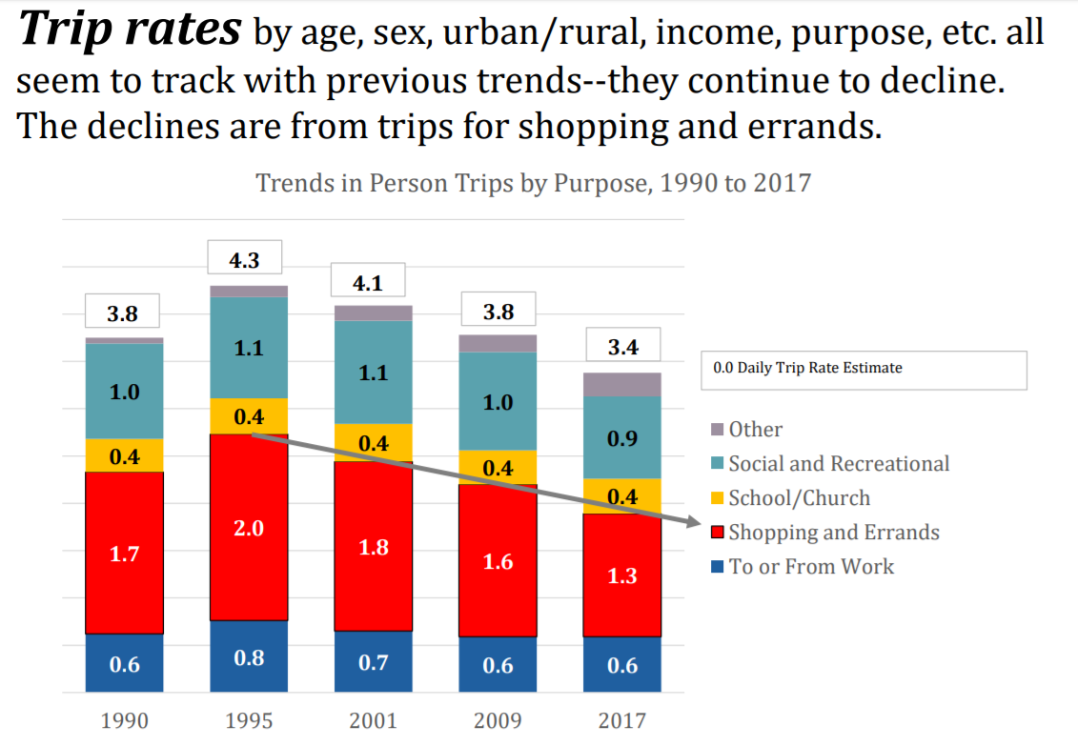
NHTS
Source: McGuckin, N. “Summary of Travel Trends Findings from the 2017 NHTS”

Slide 4
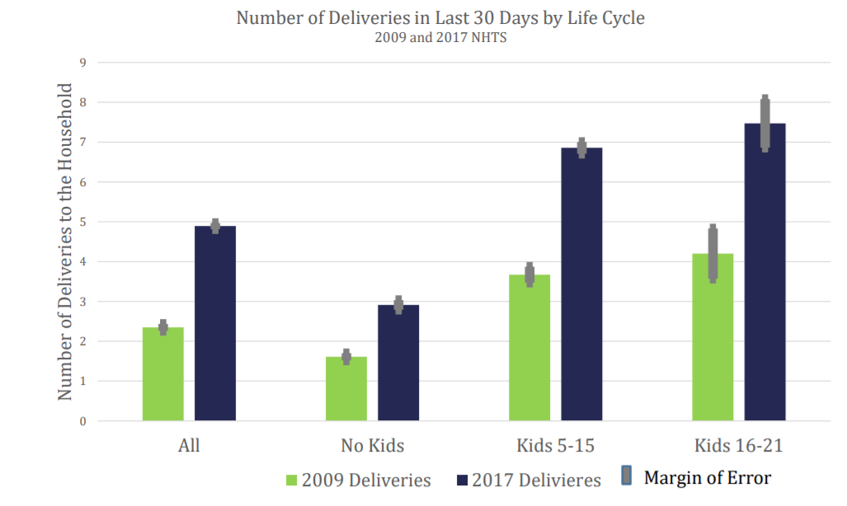
NHTS
Source: McGuckin, N. “Summary of Travel Trends Findings from the 2017 NHTS”

Slide 5
Carriers

Slide 6
Why Understand these movements
Infrastructure Planning
Curb Usage
Air Quality
Pavement Conditions
Economic Development
Land Use

Slide 7
Purpose of the Session
What data are needed to capture last mile delivery
Sources
Mechanisms of procurement
What modeling frameworks can be adapted/developed to capture these

